Slide 1
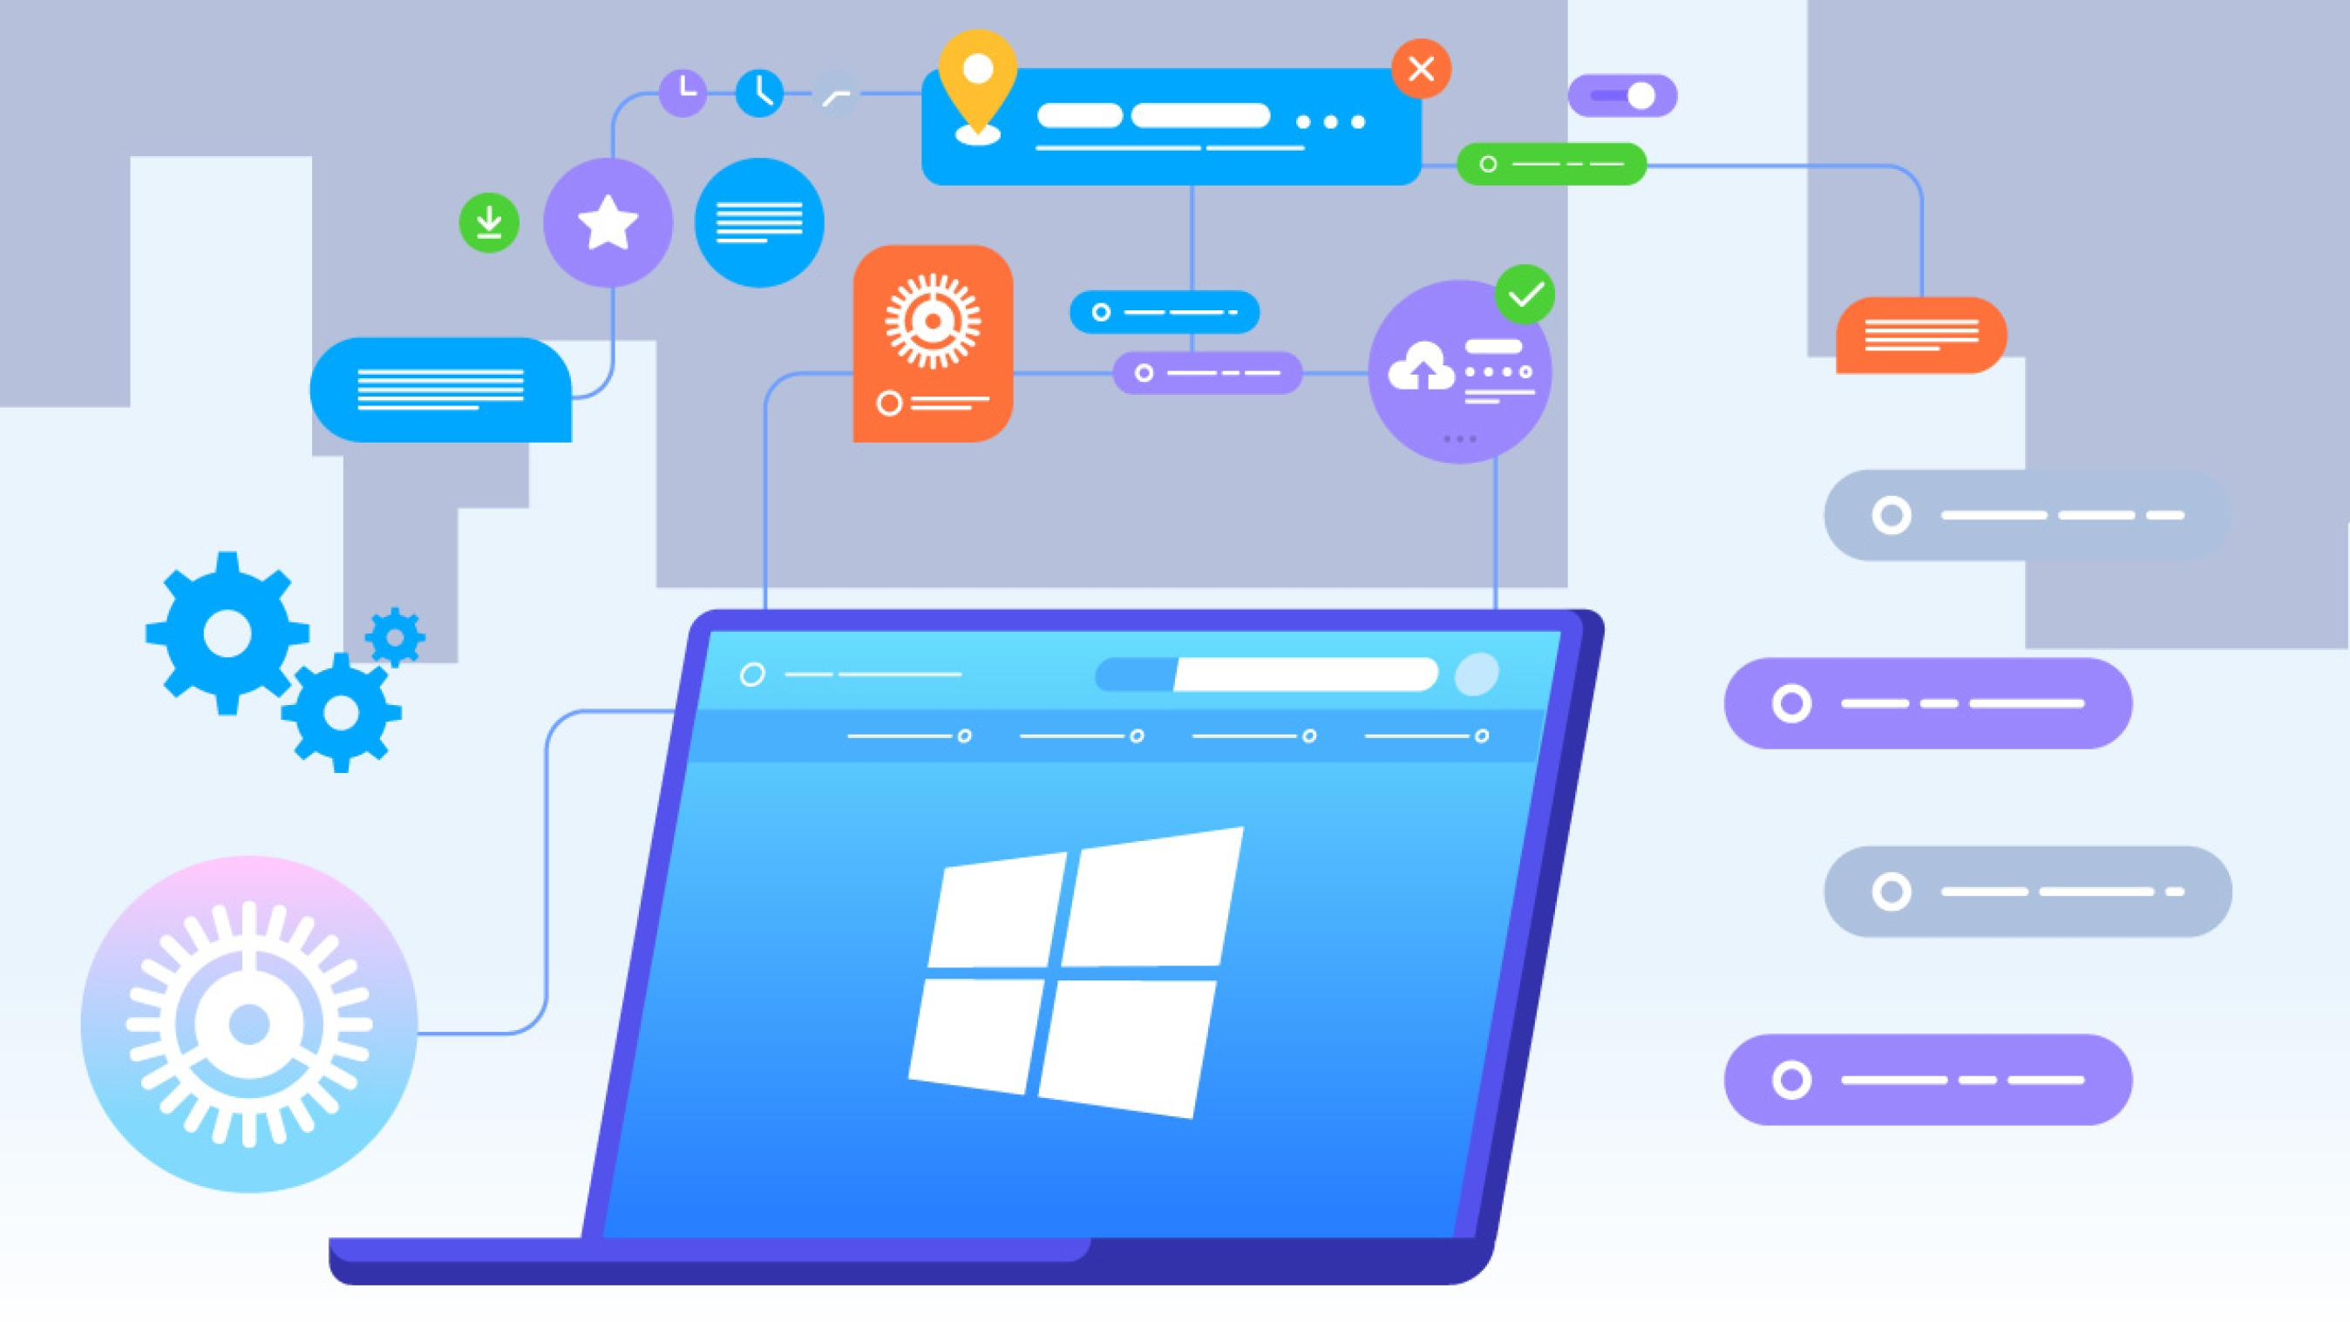
Computer software
Instructor: Engr. Hira Akash

Slide 2
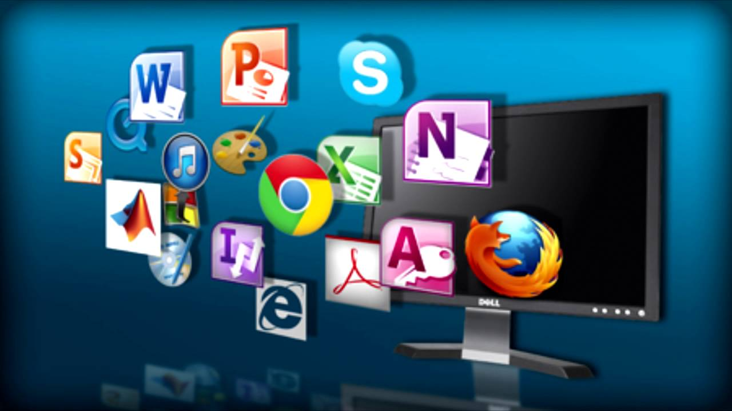
Software ?
Software Computer Instructions or data, anything that can be stored electronically is Software.
Examples:-
Ms word, excel, power point, spread sheets, library management system etc.

Slide 3
Types of Software
Types of Software
System Software
Application Software

Slide 4
System Software
The System Software consist of the Operating System and all the utilities that enable the computer to function.
System software actually controls the hardware so that application software can perform any action or task.
Example:
Operating Systems, Compiler, Loader, Linker, Interpreter and etc

Slide 5
Types of System Software
Types of System Software
Operating System
Utilities
Device Drivers
Language Translators

Slide 6
Application Software
Application Software includes programs that do real work for user.
Example:
Payroll systems, Inventory Control, Manage student database, Word Processor, Spreadsheet and Database Management System etc.,

Slide 7
Application Software
Categories of Application Software
Types of Application
Forms of Application Software

Slide 8
Categories of Application Software
Business Software
Graphic & Multimedia
Home / Personal / Education
Communication

Slide 9
Types of Application Software
Proprietary
In-house
Contract
Off-the-shelf
Customized package

Slide 10
Forms of Application Software
Packaged Software
Custom Software
Web Application
Open Source
Shareware
Freeware
Public-domain Software

Slide 11
Application Software
Actually the application software consists of programs that are designed to make users more comfortable or productive to assist personal tasks
The application software is present on computer hard disk
Application software can also be stored on CDs, DVDs, and flash or keychain storage devices

Slide 12
Type Of Application Software
Proprietary
Proprietary software is a licensed software under exclusive legal right of owner.
In-house
In In-house software we develop application with the help of company resources
Off-the-shelf
An existing software program that can be used without any changes expected.
Contract
The software which is developed for a specific company for their requirement

Slide 13
Form Of Application Software
Package software
A software which is sold in a bundle due to similar function of programs.
Example
Microsoft office
windows Cd

Slide 14
Custom Software
This is software which is specially made for an organization as per their requirement.
Example
I. Attendance system
II. Security code system.

Slide 15
Web Application
A web application is any application that uses a web browser.
Example
I. Google docs
II. Drop Box

Slide 16
Open source software
Open source software is made available to every one and can be change, modify and distribute to public without any notification.
Example
I. Linux
II. Moodle
III. Wordpress
IV. Drupal

Slide 17
Free ware
Free ware is the software that is freely available to public but author has a copy right, means that you can only use it ,not sell it.
Example
I. Antivirus

Slide 18
Share Ware
Share ware is actually delivered free of charge but some time the owner ask for money to get registered ,so that they can send updates in future.
It can be copied but cannot be sold.
Example
I. Dino Numbers
II. Microsoft office

Slide 19
Public domain software
Public domain software is totally free and it is not copyrighted plus it have no restriction Example
I. SQlite
II. Blast
III. I2P

Slide 20
System Software
In System software programs are designed to operate, control and enhances the processing capabilities of the computer
System software is developed by computer manufacturer in low level language
It also helps hardware components to work together and provide support for the development and execution of the application software
Programs which are included in system software package are known as system programs and the programmers who develop those programs are known as system programmer

